Slide 1
DSI Project 2 Exploratory Data Analysis (EDA) a.k.a. Road to humility
By Alex Yi Zhou

Slide 2
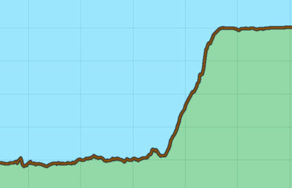
Painful progression
Q7.3
Difficulty for Alex
Progress through project 2

Slide 3

Matthew Walford

Slide 4

STATS

Slide 5
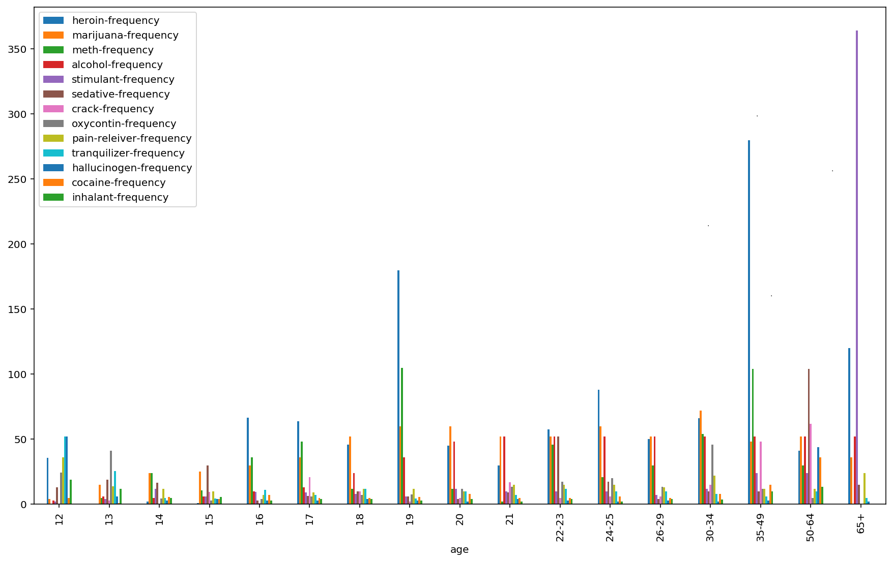
1st attempt
Question: is 65+ age group using stimulant more frequently than all other age groups combined?
Deliverables: that 65+ age group is/(is not) using stimulant more frequently than all other age groups combined

Slide 6
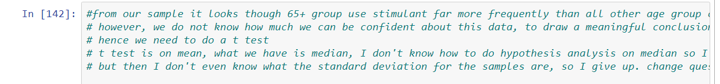
1st attempt
GIVE UP

Slide 7
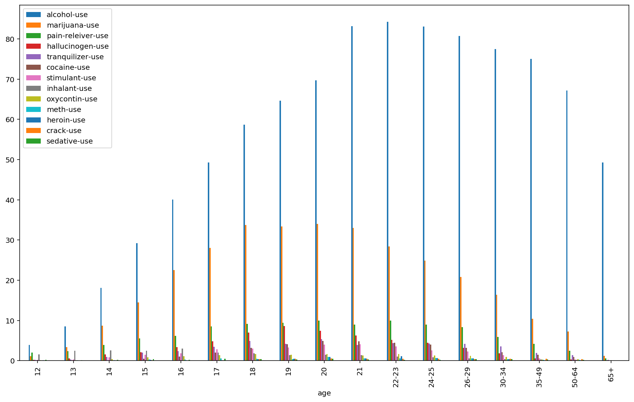
2nd attempt
Question: is there a difference in average drug use proportion between 17 and 21 year old
Deliverables: that there is/isn't a difference in average drug use proportion between 17 and 21 year old

Slide 8
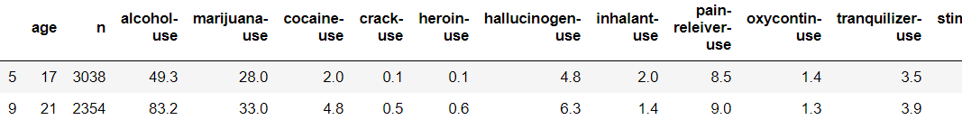
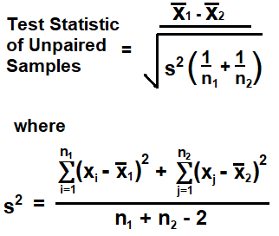

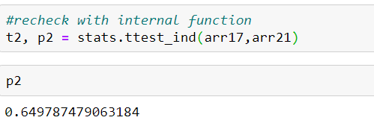
2nd attempt

Slide 9
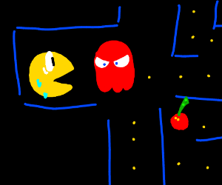
Not afraid of reaching to dead ends
No ghosts chasing me around
Pay attention to every step along the way

Slide 10
NEW YEAR RESOLUTION: learn statistics everyday

